Slide 1

Phân tích hĐT
Activity Diagrams
Notes:
NOTE:
To change the image on this slide, select the picture and delete it. Then click the Pictures icon in the placeholder to insert your own image.

Slide 2
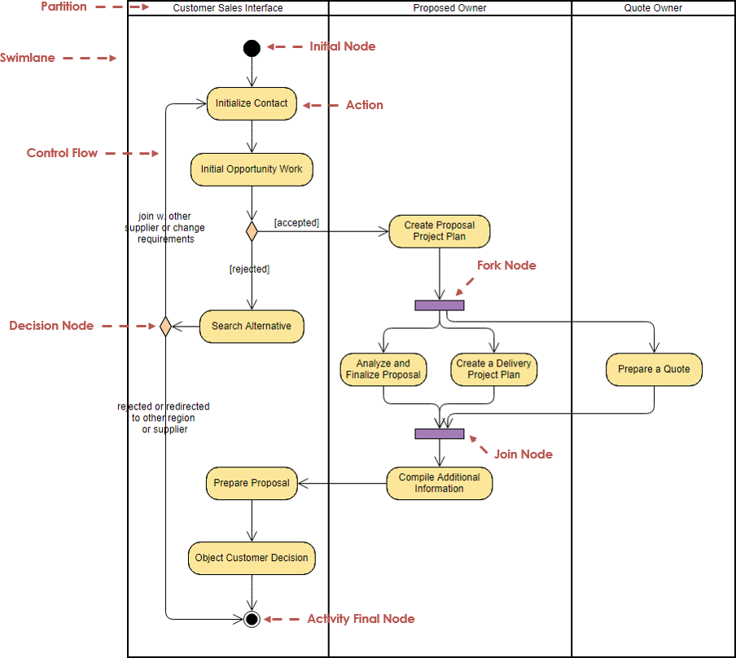
Đọc mô hình sau

Slide 3
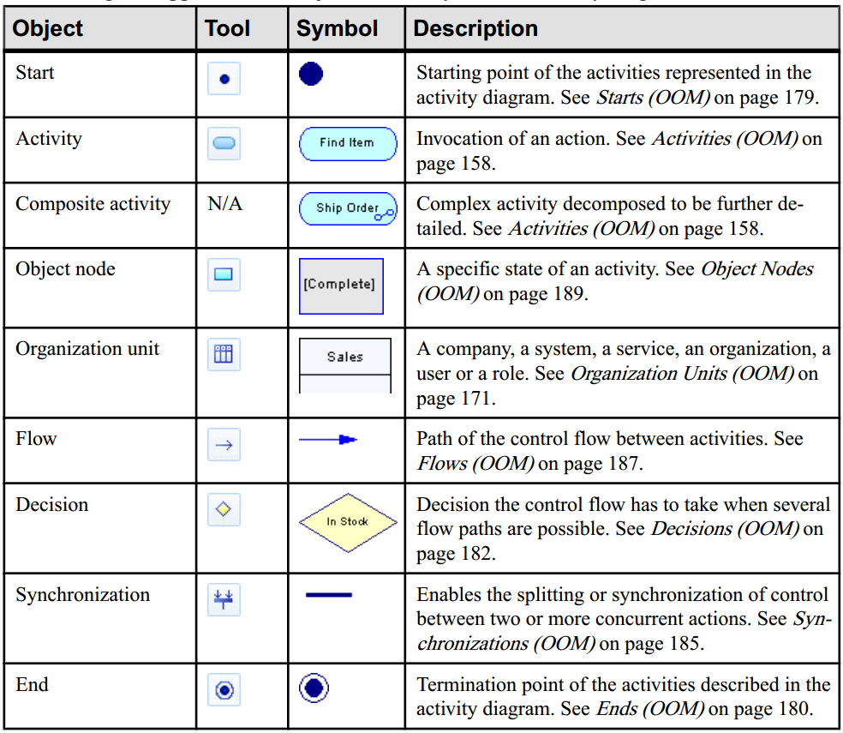
PowerDesign

Slide 4
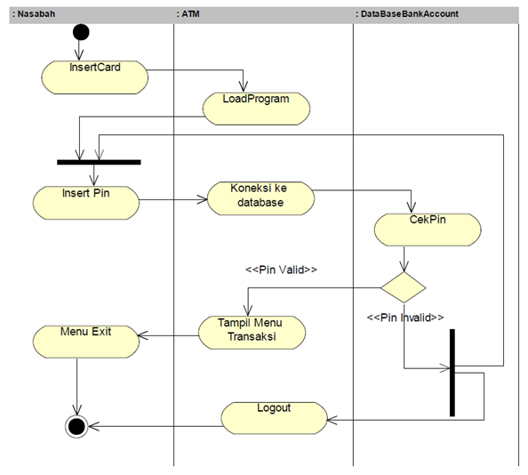
VD2

Slide 5
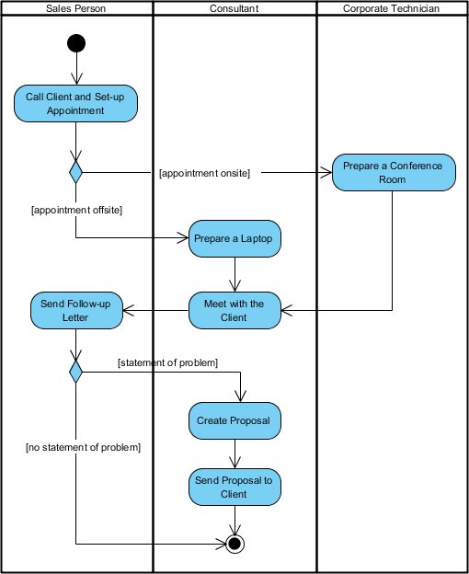
VD3

